Slide 1
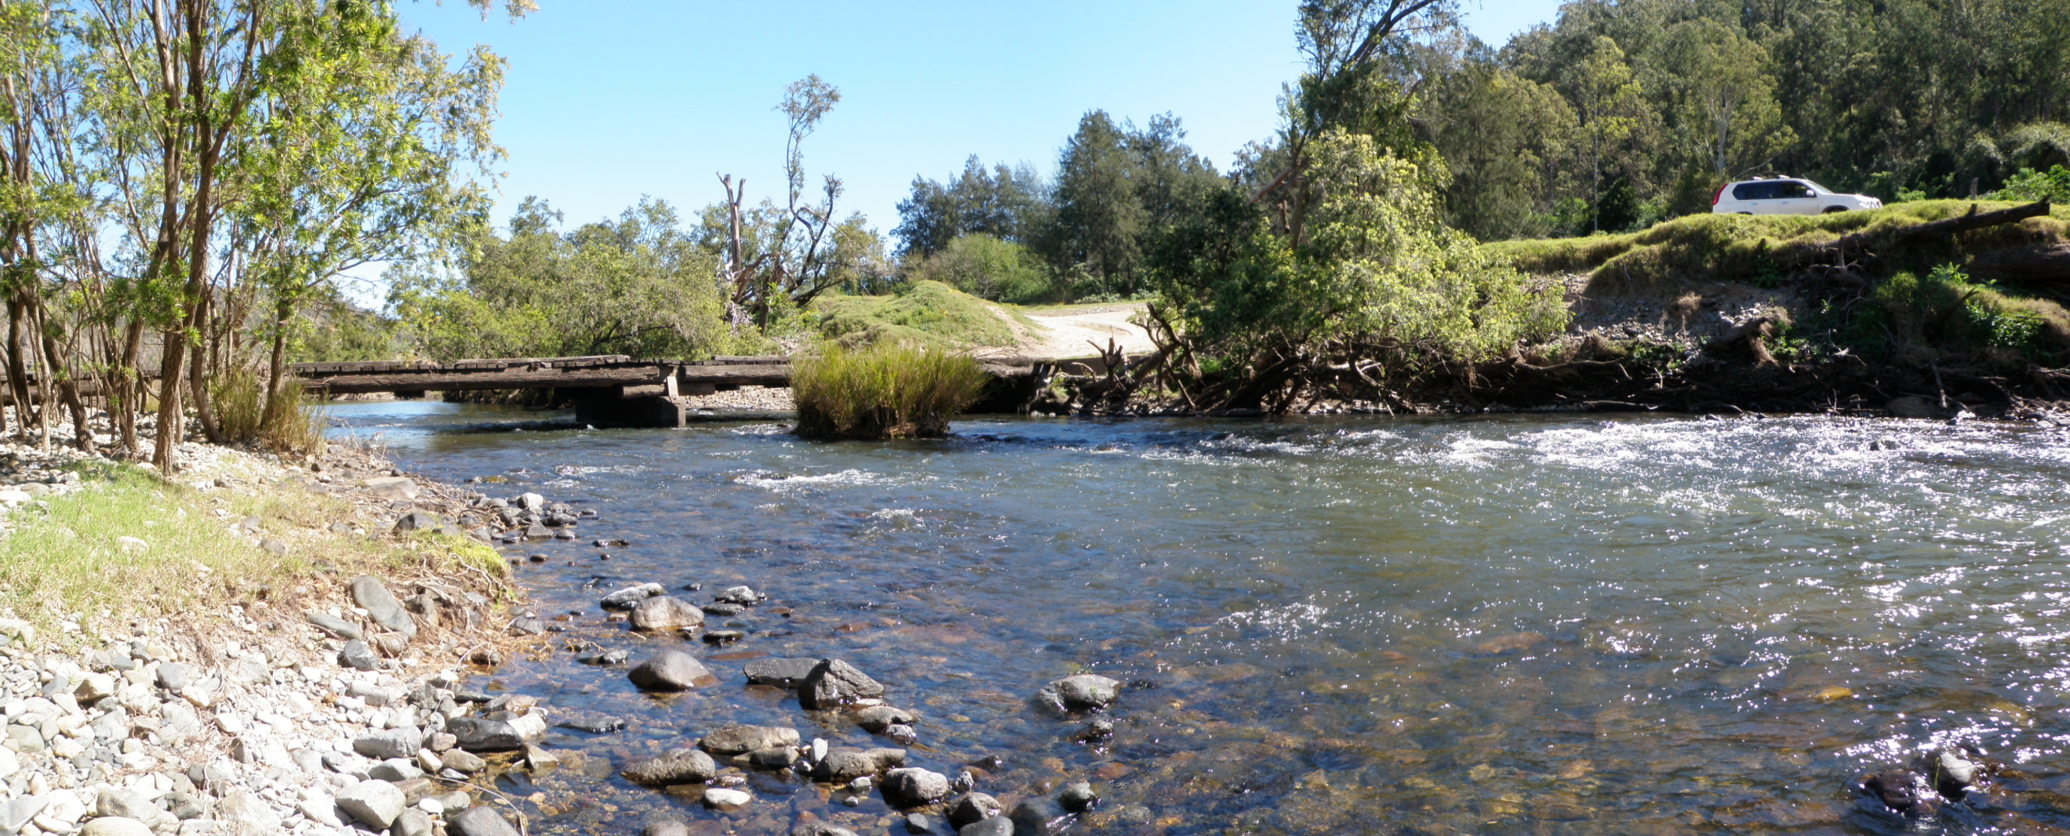
RIVERS AT RISK
Assessing and prioritising risk in NSW
river catchments
Daniel Svozil, David Workman, Jon Sayers, Michael Healey
Surface Water Science
May 2022
NSW Department of Planning and Environment
Water

Slide 2
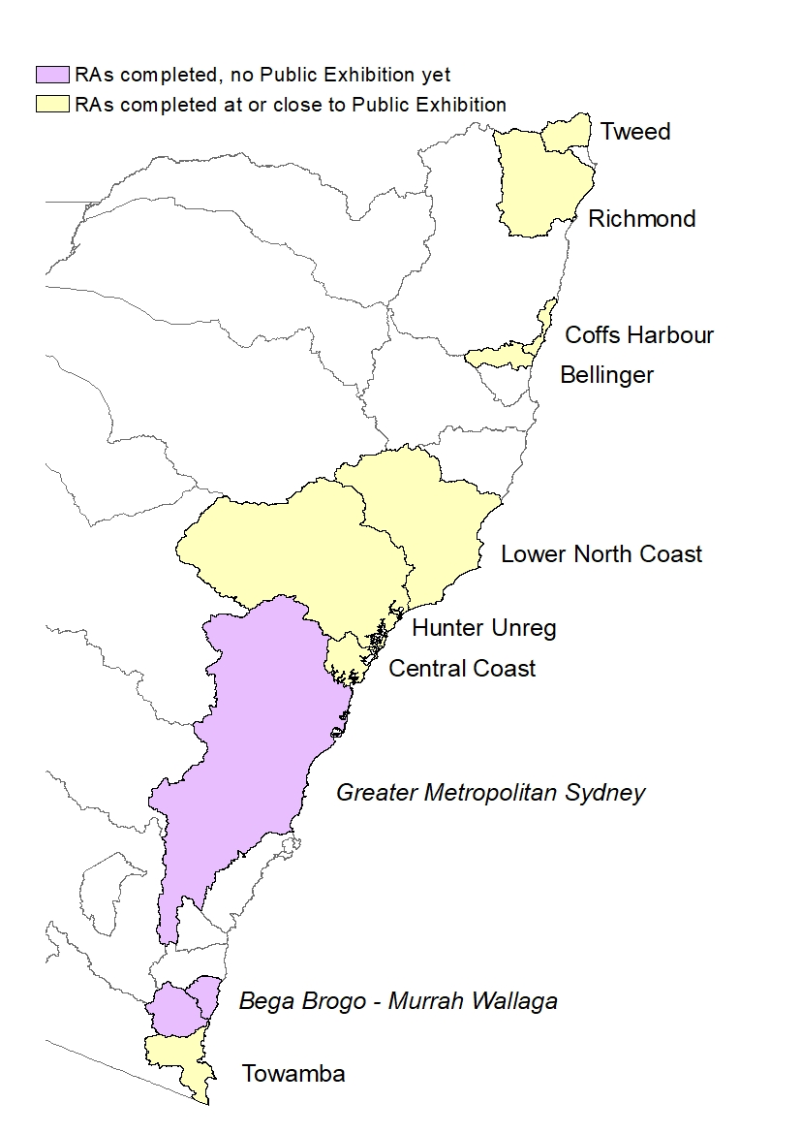
Coastal Water Sharing Plans are being remade
Progressive 10 year cycle
Bulk of coastal regions completed
Evaluation of previous Plans is vital to the remake process
Risk Assessments are part of evaluation process
Notes:
DW
NSW Water Sharing Plans are remade over a rolling 10 year cycle.
The map shows some regions have been done, and progressed to Public Exhibition in this process, some are in progress, while some are planned for the future.
An important step before remaking the plans is to evaluate the previous plan, and assess the plan performance at mitigating risks caused by extraction.
We use the Risk Assessments for that purpose.

Slide 3
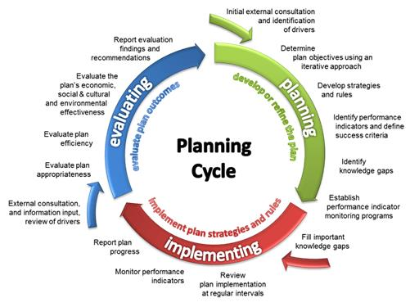
Risk Assessments – what and why?
Primary assessment tool to prioritise environmental issues before remaking Water Sharing Plans
Focal point for stakeholder engagement
Point to potential strategies
cannot mitigate all risks
focus on impacts of water sharing
Notes:
DW
-what is the risk assessment and why do we do them?
the answer is that it's our primary method to assess and prioritize environmental issues before remaking water sharing plans.
-It's a requirement of the Water Management Act that we do that. But we also see it as a focal point for stakeholder engagement when we identify issues and take them to the community.
-The risk assessment also points to potential strategies to address the issues that we've identified.
It's important to note that we can't mitigate all the risks that we identify. We have to focus on those risks that are impacts of water sharing plans, and typically these are flow related risks.
-You can see to the right where the risk assessment fits in the planning cycle, it's part of the reporting on the evaluation findings and recommendations from the evaluation process.

Slide 4
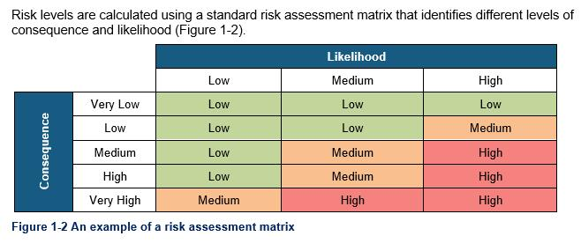
Risk Assessments – why update?
Continuous improvement and consistency with inland procedures
Many data sources discontinued or obsolete
Additional data now available
Risk based methodology
Consequence
Likelihood
Notes:
DW
But why did they need updating is probably the next question ... They were all done in the last 10 years in a form, but...
-Firstly - we want to continuously improve.
We don't for a minute imagine that the risk assessments are perfect.
They are the best information we can provide at the time that we do them, so they do need updating, and need to be reasonably current when a plan is being remade.
-Also, you'll see shortly that that to do this assessment, we rely on a very large number of data sources from a very wide array of sources we've got data from fisheries, EES/EHG, councils, Aboriginal and First Nations lands and a whole bunch of data sets, that continuously get updated or continuously fall out of date as new products become available. And of course, new data from new studies becomes available that we'd like to include to make the assessments more robust.
-We also wanted to make sure that we had consistency in the new coastal water sharing plan procedures with the processes that we went through in doing the basin plan in the inland water sharing plans.
-And the final Driver for updating was to move to a risk based methodology in line with the basin plan requirements and requirements in the WM Act
-You can see to the lower right the general basic theory of a risk assessment is it involves a combination of the consequence if an event happened and the likelihood of that event happening.
-It’s very similar to work health safety risk matrixes and business risk matrixes, which I’m sure most of you will have seen.

Slide 5
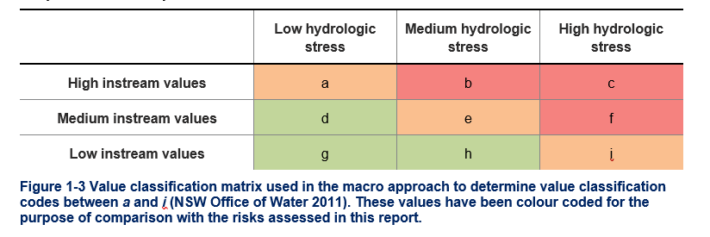
What’s different to previous macro Assessments?
Hydrological models and metrics
Likelihood of impact at high and low flows vs single hydrostress
Impact of extraction on different flow components
High Ecological Value Aquatic Ecosystems (HEVAE)
Estuary Inflow risks at Water Source scale
Water Quality risks assessed where data is available
Notes:
DW
The difference to the previous macro assessments is the way we’ve approached the hydrological modelling. We now rate alterations at different flow components, whereas previously it was just a hydro stress.
So we now offer a likelihood for high flow and a high likelihood for low flow.
We've also extended the HEVAE, and Michael will talk about that shortly
In addition, we're looking at the tidal pools for risks to estuary inflows, which Mick will also discuss.
And finally, we’re also looking at water quality risks where, where data is available.
Top right you can see an example of how we used to approach hydrologic stress and risk in a two-step process... and you can say it's rather more complex, and it’s debatable whether it was giving full effect to the WM Act priorities.
And now I’m going to hand you over to Michael Healey, and he’ll describe HEVAE and the method for scoring values.

Slide 6
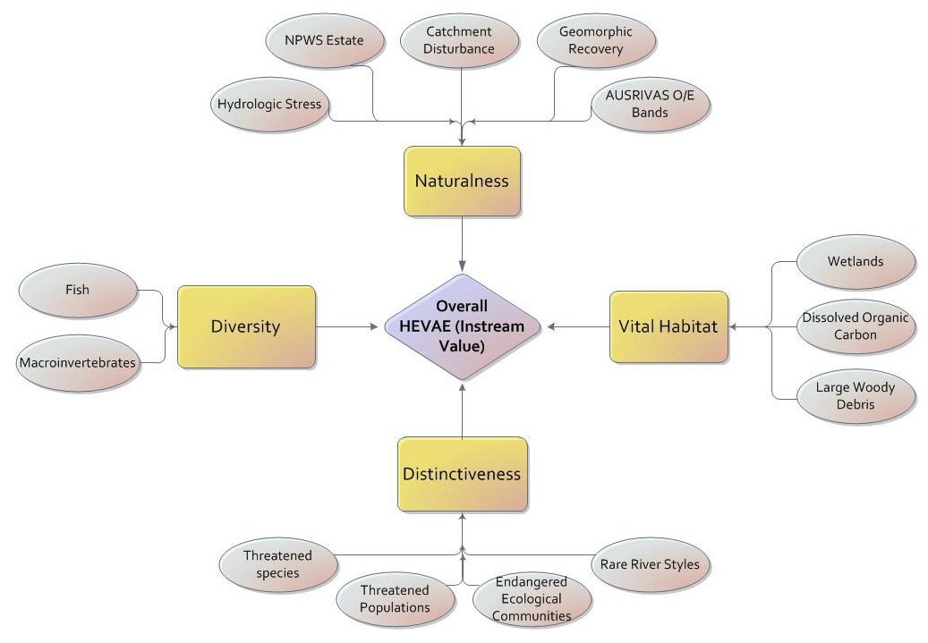
High Ecological Value Aquatic Ecosystems (HEVAE)
Best practice approach
Consistent approach for WSPs
Coastal datasets different
Scoring and weighting = prioritisation
Reach-based outcomes
Sub-catchment outcomes using
Decision tree
Available online
Notes:
MH
The HEVAE (Commonwealth Gov 2012) is part of The Aquatic Ecosystems Toolkit and is a nationally agreed framework that provides a set of best practice tools for mapping, classifying and assessing the condition of aquatic ecosystems, and provides guidance to identify high ecological value aquatic ecosystems (HEVAE).
The 2014 Northern Basin Review recognised the HEVAE framework/process as a best practice approach to the identification of instream assets
Prioritisation is used to focus management needs on issues of highest importance
Scoring system to accommodate a range of assets/values
Scores categorised & best outcomes (reach level) receive highest scores
Weighting to assist prioritisation of river reaches including:
- Flow sensitivity (4 = highest to 1 = lowest. eg: fish are a 4)
The Decision Tree process takes into account
the presence of high or low HEVAE river reaches,
the location of instream values relative to where surface water extraction is occurring. &
The dependency of the attributes on river flow
The overall HEVAE determined is called the consequence and then links into the risk calculation for each water source.

Slide 7
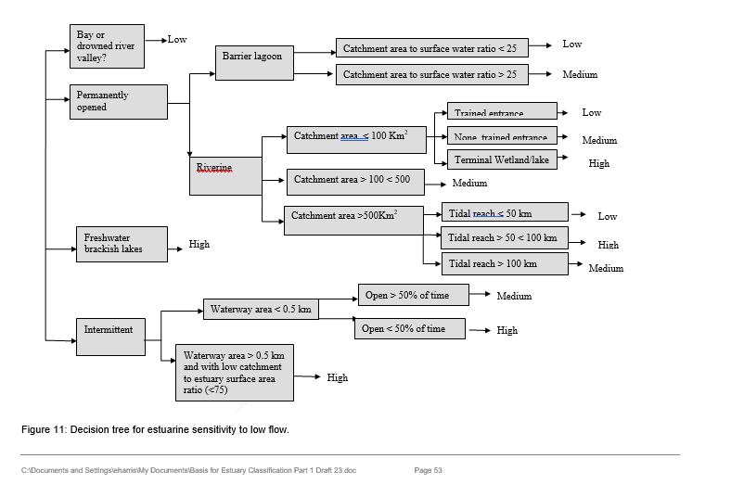
Estuary Inflow Assessment
Value or consequence assessment aligned with HEVAE method
Uses upstream hydro models for likelihood, water source scale
Also includes sensitivity, inherent characteristic - physical properties
Notes:
MH
Estuary value assessments were undertaken as many estuaries are reliant on freshwater inflows to enable the seasonal migration of some fish species, the inflow of nutrients to drive estuary productivity and influence the geomorphology of these areas.
Large tidal pools can also have a large volume of water extraction, and many ICOLS are influenced by the volume of and seasonality of freshwater inflows.
This assessment is aligned with the HEVAE/consequence process. For example estuary values are determined and this is then adjusted according to the sensitivity to loss of low and high inflows for each estuary. The likelihood is derived from the likelihood metric for low and high flow from the freshwater water source immediately above the tidal pool/estuary. Reduction of the low and high inflows was rated high probability of impacting the ecological functioning. Risk outcomes are the combination of the Consequence and Likelihood.
The decision tree shown here is one developed to determine the estuary sensitivity to low flow inflows and is based in the physical characteristics or type, catchment area, tidal reach size and/or the characteristics of the entrance.
Although the estuary process is unable be considered as part of the risk assessment scope, it is important to do to inform on the potential impact that upstream extraction can have on the estuary and the ecological, social, cultural and economic values within them.

Slide 8
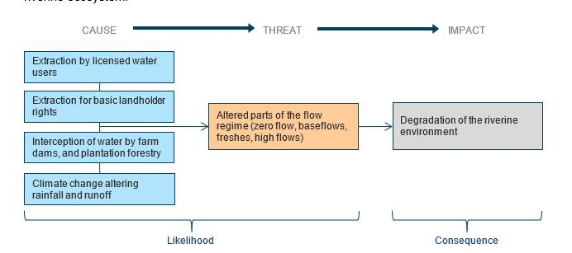
Hydrologic modelling (Likelihood)
Examines impacts of extraction and how it alters the flow regime
Attempting to capture cumulative impacts
Two model scenarios
natural flows vs full development
change to flow components
Rate level of alteration
High, Medium, Low
likelihood component of Risk
Notes:
JS
Modelling was used to evaluate the likelihood of changing the functioning of the ecology of the rivers
The changes to flow of both extraction and the interception of flow can be seen in the modelling – enabling us to quantify the level of alteration of the flow regime
Water is taken in a number of ways, which leads to a communitive impact that is able to be simulated in the models
2 model runs are compared, one representing the natural flows, and the other showing full use of water licences and water rights to take water
Comparing the change in flow between these model runs allowed us to evaluate the changes in 6 flow components (I’ll look at these component in the next slide)
The amount of alteration seen in the modelling was rated into 3 level of “Likelihood”; High, Medium, and low likelihood of impacting key riverine ecosystem functions
These rating are combined with the “Consequence” rating to provide the “Risk” rating

Slide 9
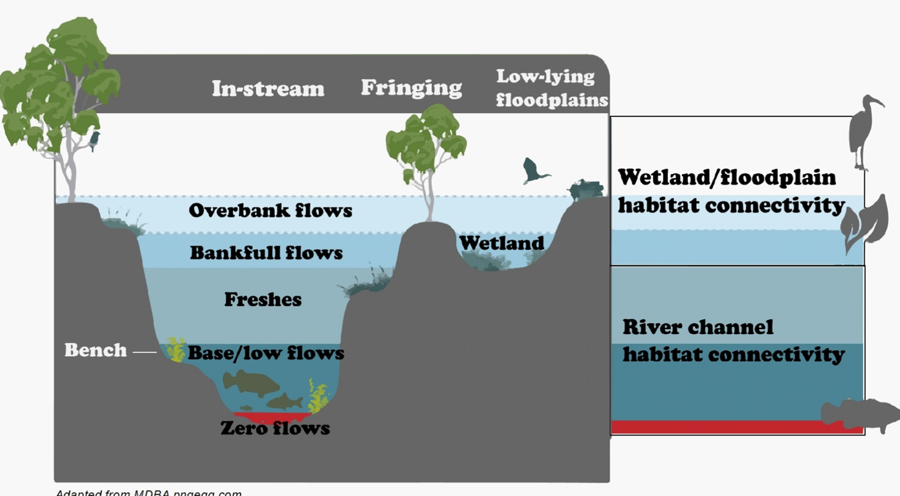
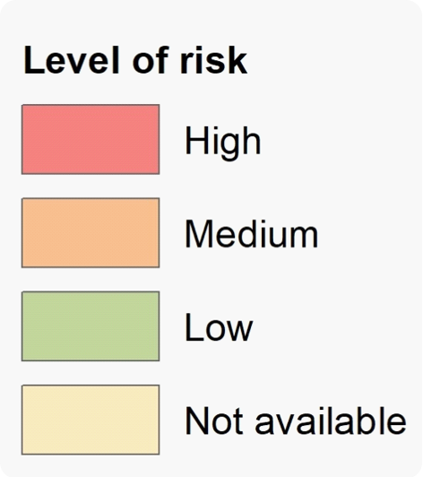
Notes:
JS
The 6 flow components are: 1) the zero or cease to flow periods, 2) the low flows, 3) the freshes withing the river channel, and 3 higher flows that are bankfull and slightly higher (not floods) (point to the bottom image)
These are evaluated by comparing flows from the 2 model runs to generate 17 metrics – the Key Ecosystem Metrics, which are rolled up to rate the likelihood in the 6 flow ranges
The importance of the flow components (or parts of the flow regime) are varied, but some of the main concerns for the ecology in each of the 6 are:
Zero flows periods if too frequent can lead to reduced biota populations and condition
Low flows if too frequent can lead to limited connectivity and loss of migration so biota/fish can move to better pools for food and better water quality
Freshes are importing for resting the water quality and longitudinal connectivity (moving along the river) for lifecycle events (e.g. spawning)
The higher flows provide lateral connectivity (connection with associated wetlands and billabongs) and inputs to the food web - And longitudinal connectivity (point to the lower image)
The example maps are for the risk to the different flow ranges in the Tweed WSP Area (note the 3 high flow metrics are represented by the last map)

Slide 10
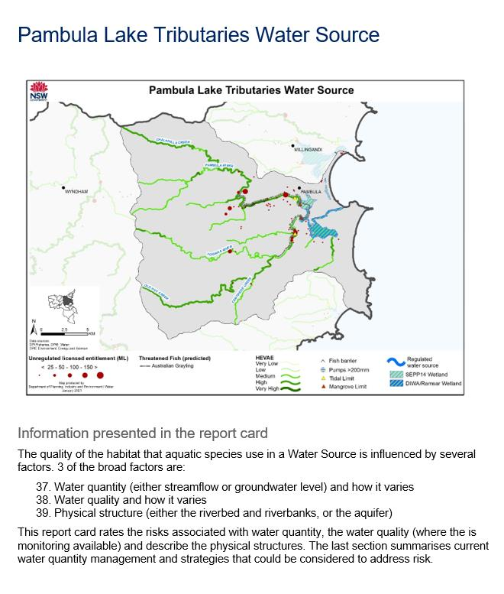
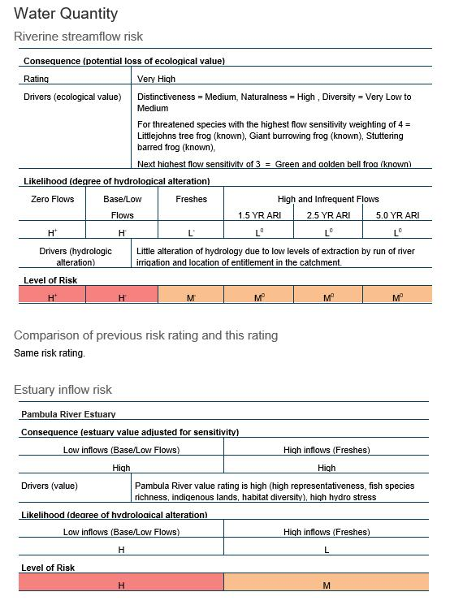
Consequence rating
Drivers for consequence rating
Flow component being rated
Likelihood rating
1.
2.
3.
Risk rating
Notes:
JS? MH?
This is an example of the Report Card for a specific Water Source (in this case the Pambula Lake Tributaries Water Source)
This is one of the main products from the risk assessment process, which provides an in-depth look at each Water Source
The Map shows the ecological values that are identified in the HEVAE rating
The Risk information is presented in tables
Consequence (refer to table)
The ecologic values the are the drivers for the rating of Consequence (refer to table)
The 6 flow components
Likelihood ratings for each of the components
And the Risk ratings for each of the components
Note a equivalent approach is also presented for the inflows to the estuarine reaches

Slide 11
Questions?
Further information
Likelihood – Surface water models for WSPs: https://www.industry.nsw.gov.au/water/science/modelling/surface-groundwater-models
HEVAE: https://www.dpie.nsw.gov.au/water/science-data-and-modelling/surface-water/monitoring-changes/environmental-value-of-nsw-rivers-hevae
Brief overview of risk assessment: https://www.dpie.nsw.gov.au/water/science-data-and-modelling/surface-water/monitoring-changes
NSW Coastal WSPs and associated risk assessments on public exhibition: https://www.industry.nsw.gov.au/water/plans-programs/water-sharing-plans/recently-on-public-exhibition

